Slide 1

GLA University
Presentation on
To Your Door
OF
BACHELOR OF ENGINEERING
IN
COMPUTER SCIENCE ENGINEERING
By
Shahid Khan (201500638)
Arpit Tyagi (201500141)
Muhd Aasim Waseem (201500417)
Anurag Sharma (201500126)
Under the Guidance of
Ms. Gurpreet Kaur
AI RADIO
Page - 1

Slide 2

Content
Introduction
Problem Statement
Technology Used
Working
Demo
Conclusion
AI RADIO
Page - 2

Slide 3
Introduction
A few years back, ordering food would It means placing a phone call to say What a customer wants and then waits for it to arrive. Now, food delivery has wrapped with the old technology and People have started using food delivery applications or website. Recently, in our university, a shopping complex was constructed and started, so it was not feasible for students to go there and wait for their food and waste time as it is very precious time for us, so we thought we could help our students and university by providing this website. The biggest reason for this is that it is much easier to use and food can be received in a short while. It is great for students as well as teachers.
AI RADIO
Page - 3
Notes:
Flutter is an open source framework by Google for building beautiful, natively compiled, multi-platform applications from a single codebase.

Slide 4
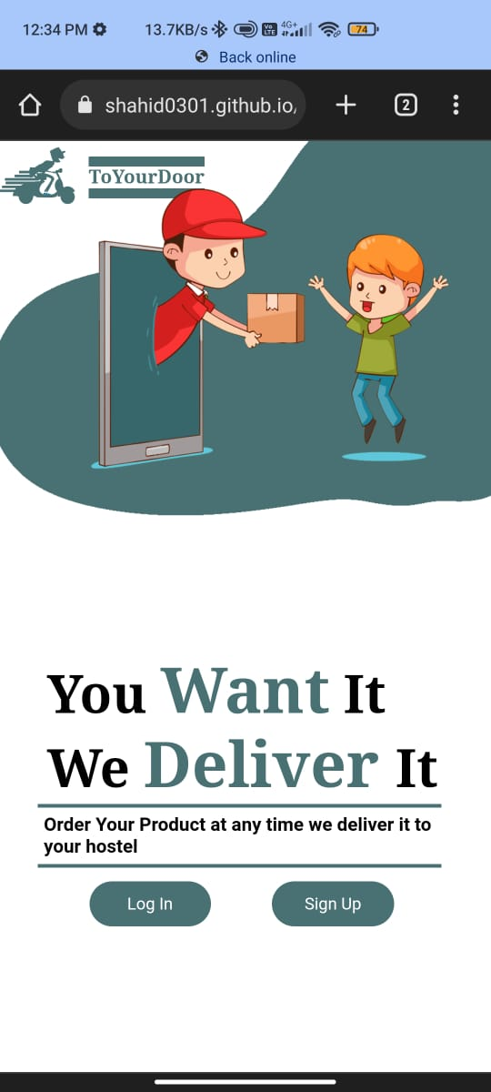
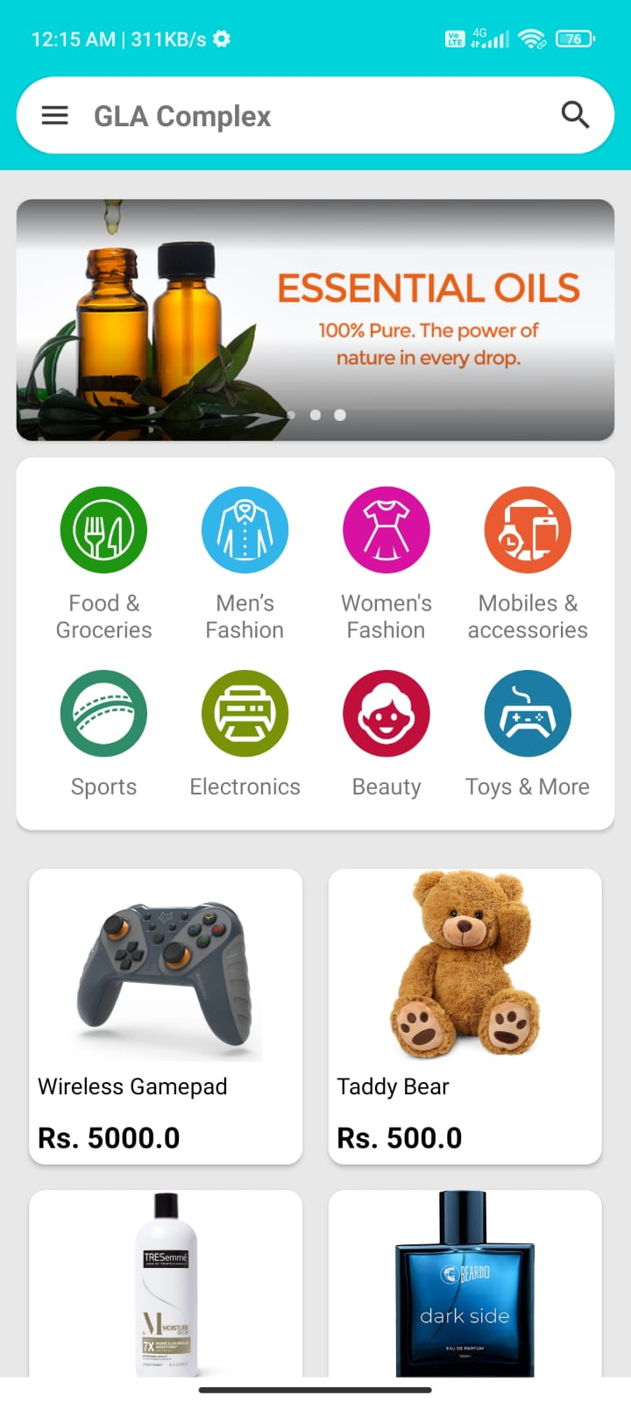
Introduction
To Your Door
Online Food Ordering Website for GLA University Complex
Work on Android devices and laptops
Login Screen
Home Screen with Drawer , slider, Shop, and menu
Product detail screen
Technology Used -
HTML
CSS
BOOTSTRAP
JAVASCRIPT
PHP
AI RADIO
Page - 4
Notes:
Flutter is an open source framework by Google for building beautiful, natively compiled, multi-platform applications from a single codebase.

Slide 5



Problem Statement
Online Food Ordering option for university campus and get product delivered to hostel room.
Platform to take Shopping Complex products and services online.
AI RADIO
Page - 5
Notes:
Flutter is an open source framework by Google for building beautiful, natively compiled, multi-platform applications from a single codebase.

Slide 6
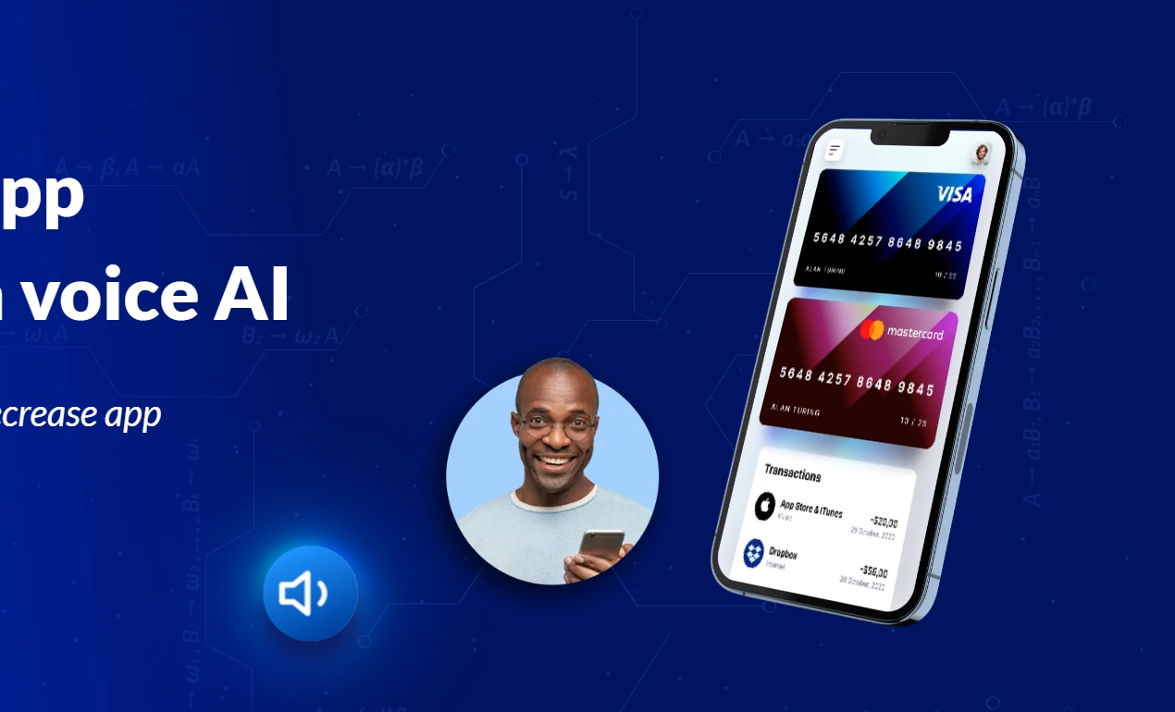
Technology Used
HTML
HTML stands for HyperText Markup Language. It is used to design web pages using a markup language. HTML is the combination of Hypertext and Markup language. Hypertext defines the link between the web pages. A markup language is used to define the text document within tag which defines the structure of web pages.
CSS
CSS (Cascading Style Sheets) is a stylesheet language used to design the webpage to make it attractive. The reason for using CSS is to simplify the process of making web pages presentable. CSS allows you to apply styles to web pages. More importantly, CSS enables you to do this independent of the HTML that makes up each web page.
AI RADIO
Page - 6
Notes:
Flutter is an open source framework by Google for building beautiful, natively compiled, multi-platform applications from a single codebase.

Slide 7
Technology Used
BOOTSTRAP
Bootstrap is the most popular HTML, CSS and JavaScript framework for developing a responsive and mobile friendly website.
It is absolutely free to download and use.
It is a front-end framework used for easier and faster web development.
It includes HTML and CSS based design templates for typography, forms, buttons, tables, navigation.
PHP
Firebase is a set of hosting services for any type of application (Android, iOS, Javascript, Node.js, Java, etc.). It offers NoSQL and real-time hosting of databases, content, social authentication (Google, Facebook, Twitter, etc.)
AI RADIO
Page - 7
Notes:
Flutter is an open source framework by Google for building beautiful, natively compiled, multi-platform applications from a single codebase.

Slide 8
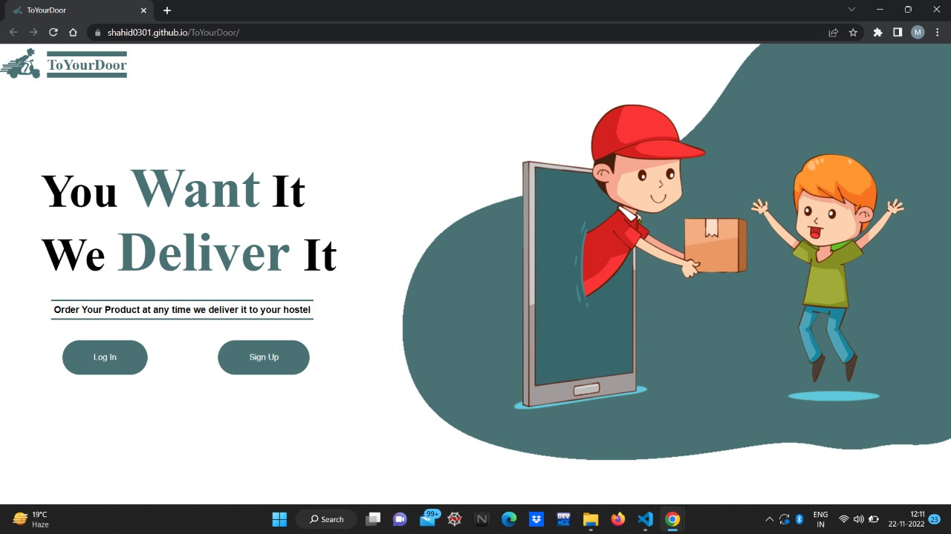

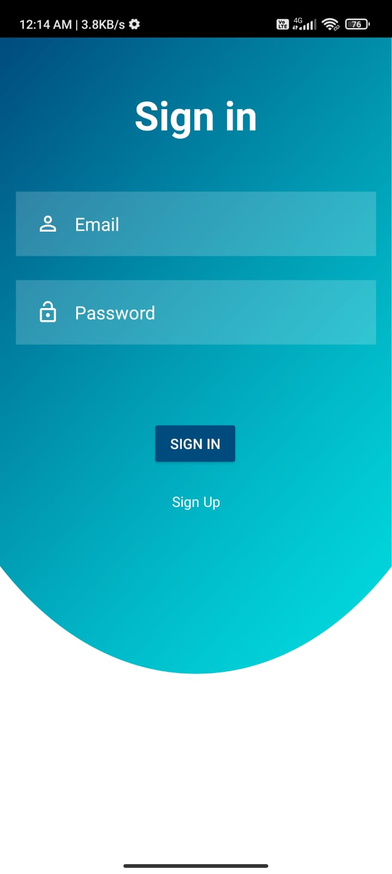
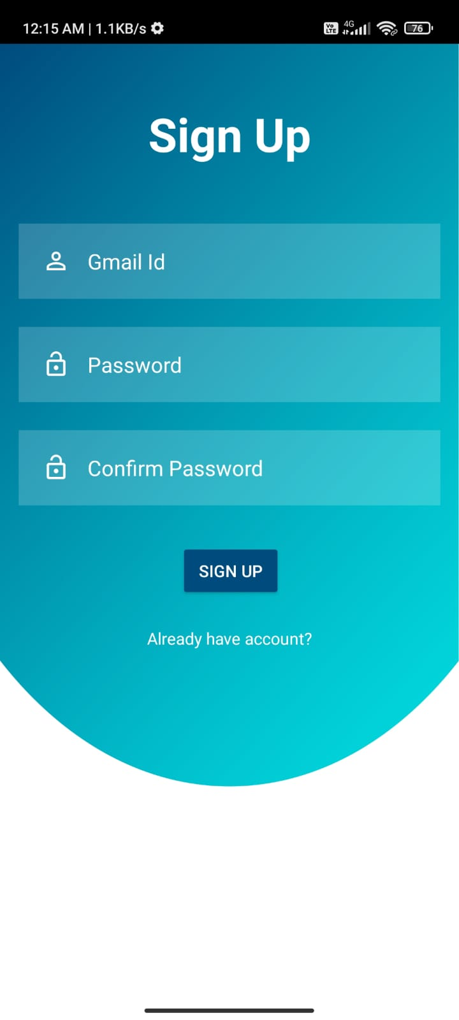
Working
Start
AI RADIO
Page - 9
Notes:
Flutter is an open source framework by Google for building beautiful, natively compiled, multi-platform applications from a single codebase.

Slide 9
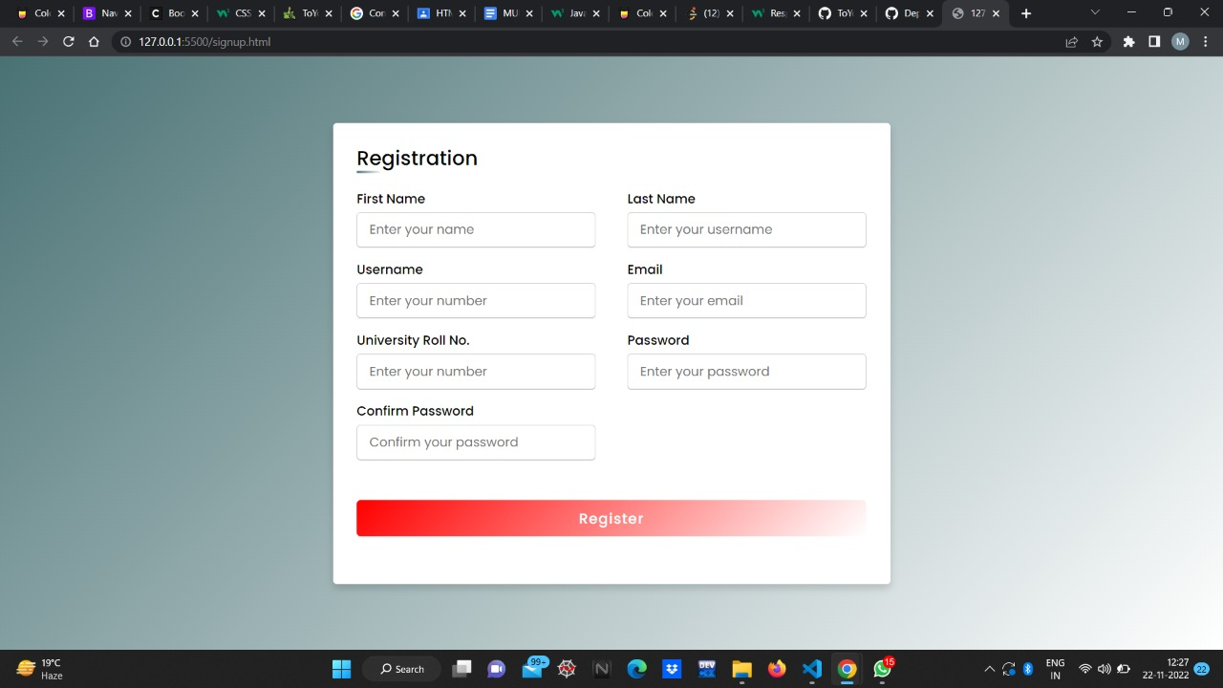
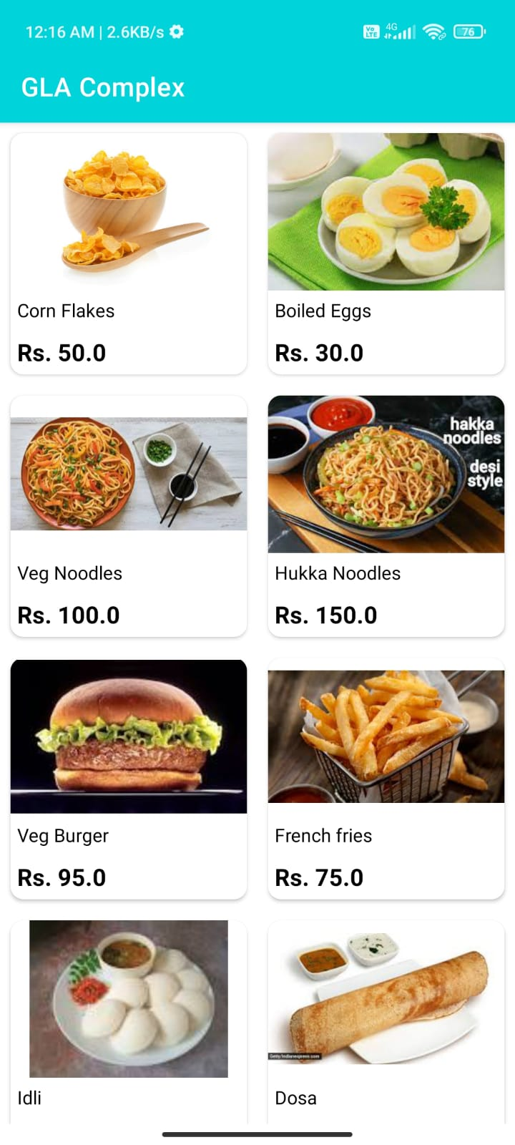
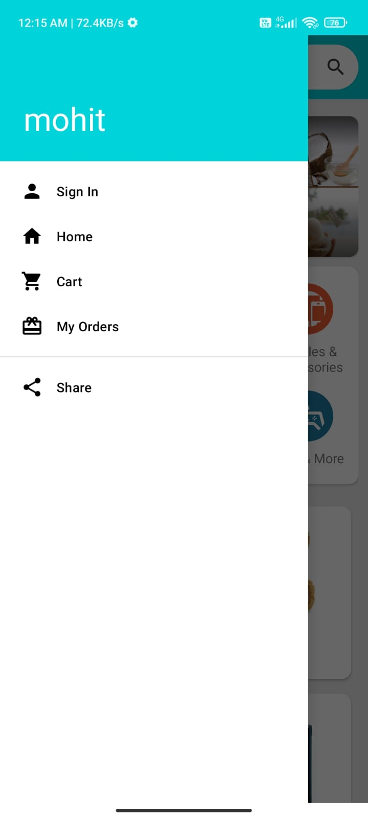
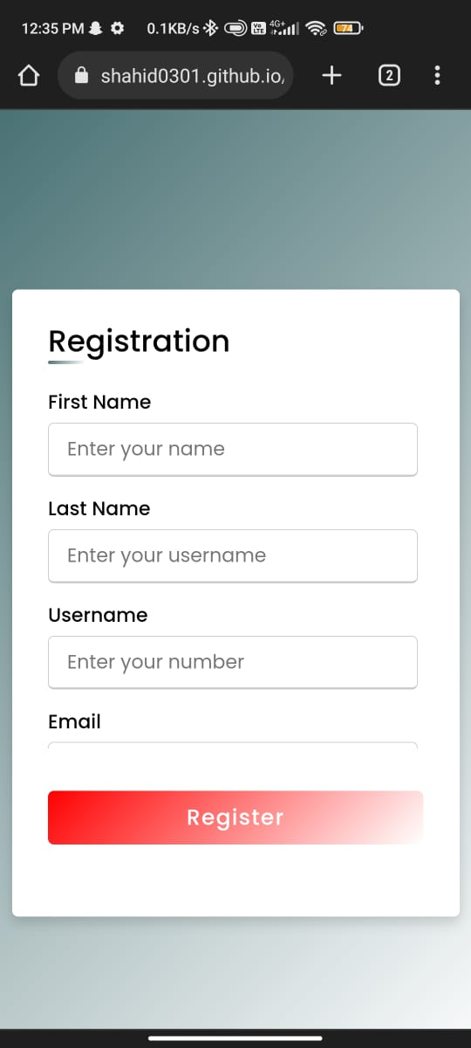
Working
AI RADIO
Page - 10

Slide 10
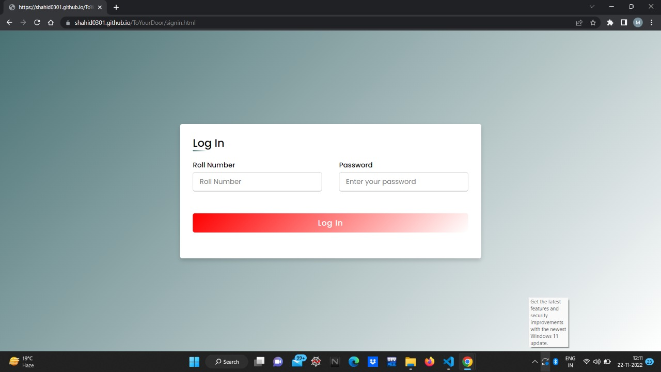
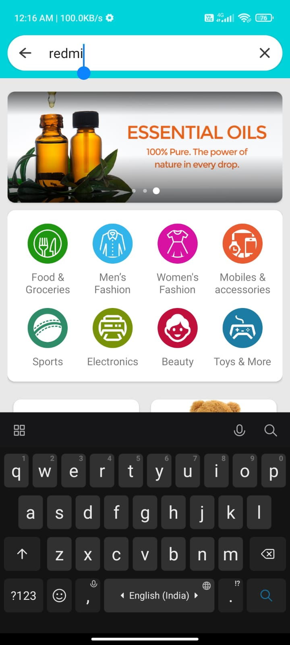
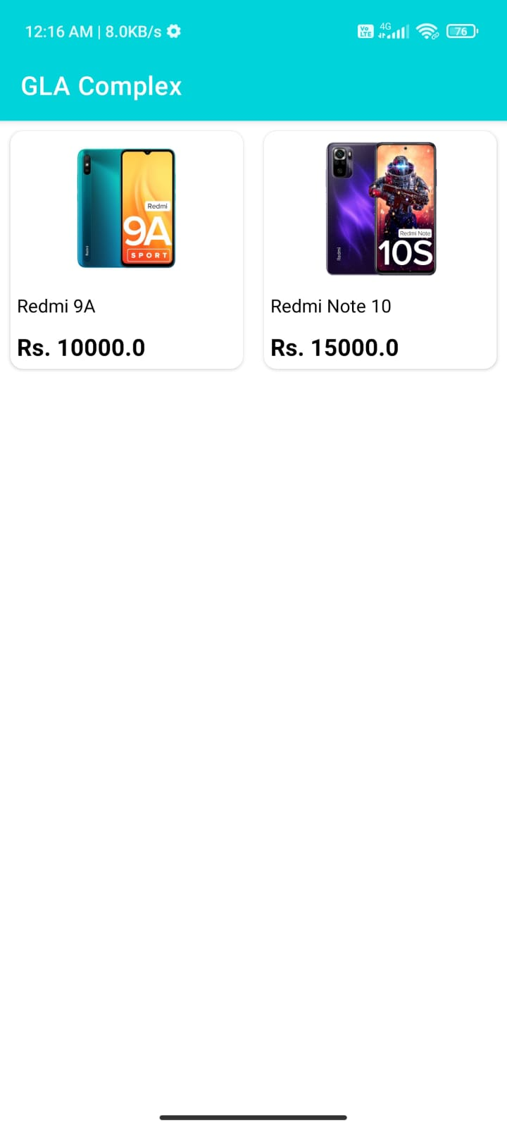
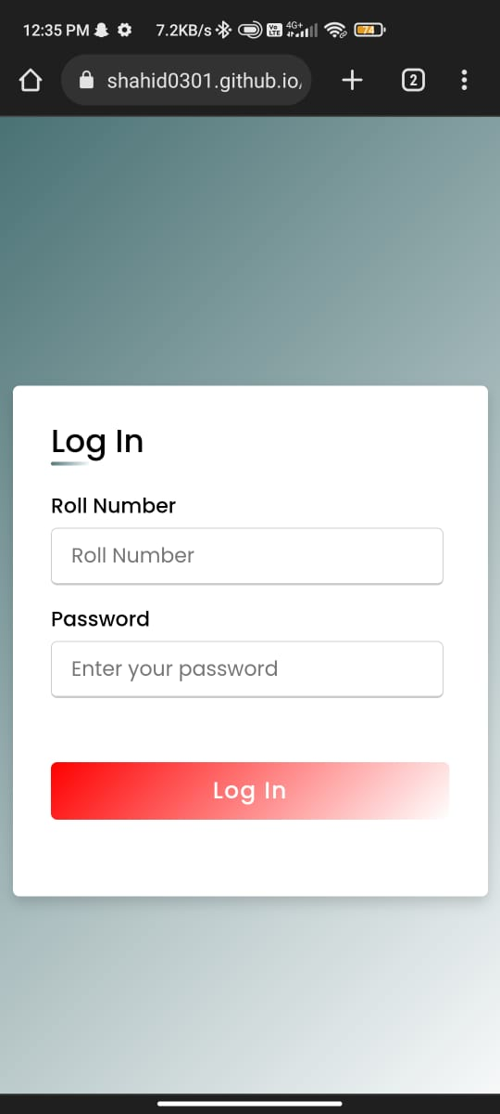
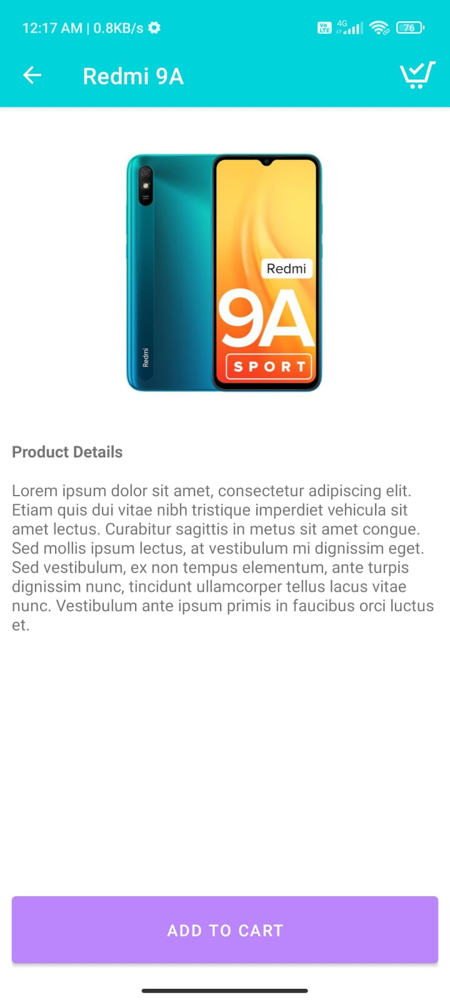
Working
AI RADIO
Page - 11
Notes:
Flutter is an open source framework by Google for building beautiful, natively compiled, multi-platform applications from a single codebase.

Slide 11
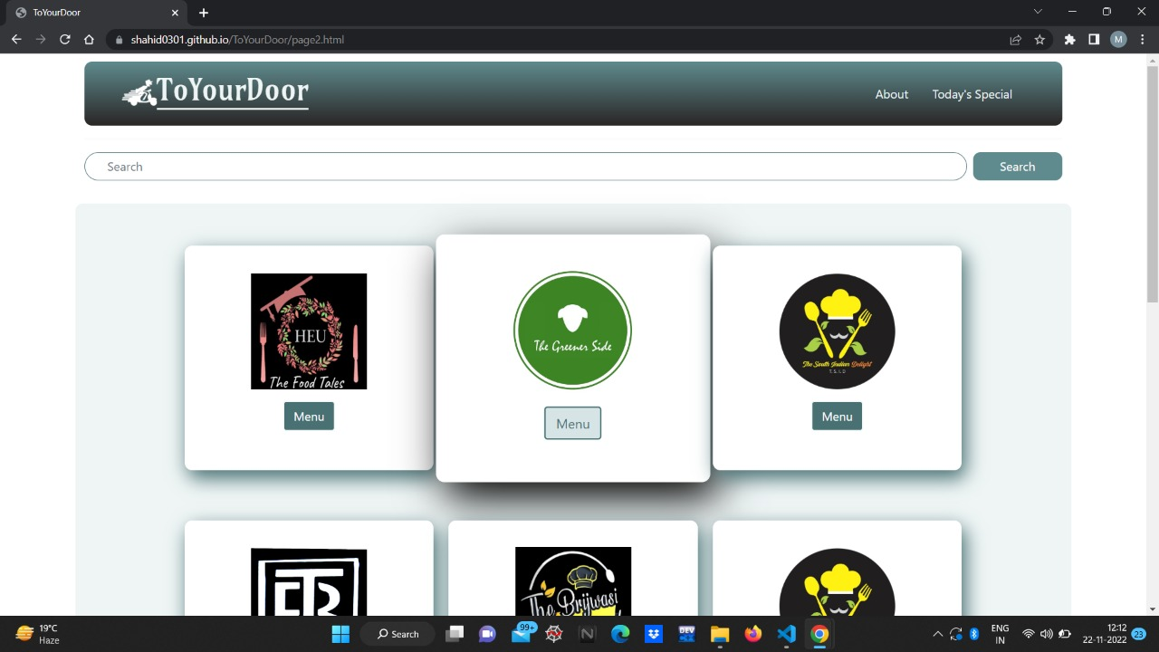
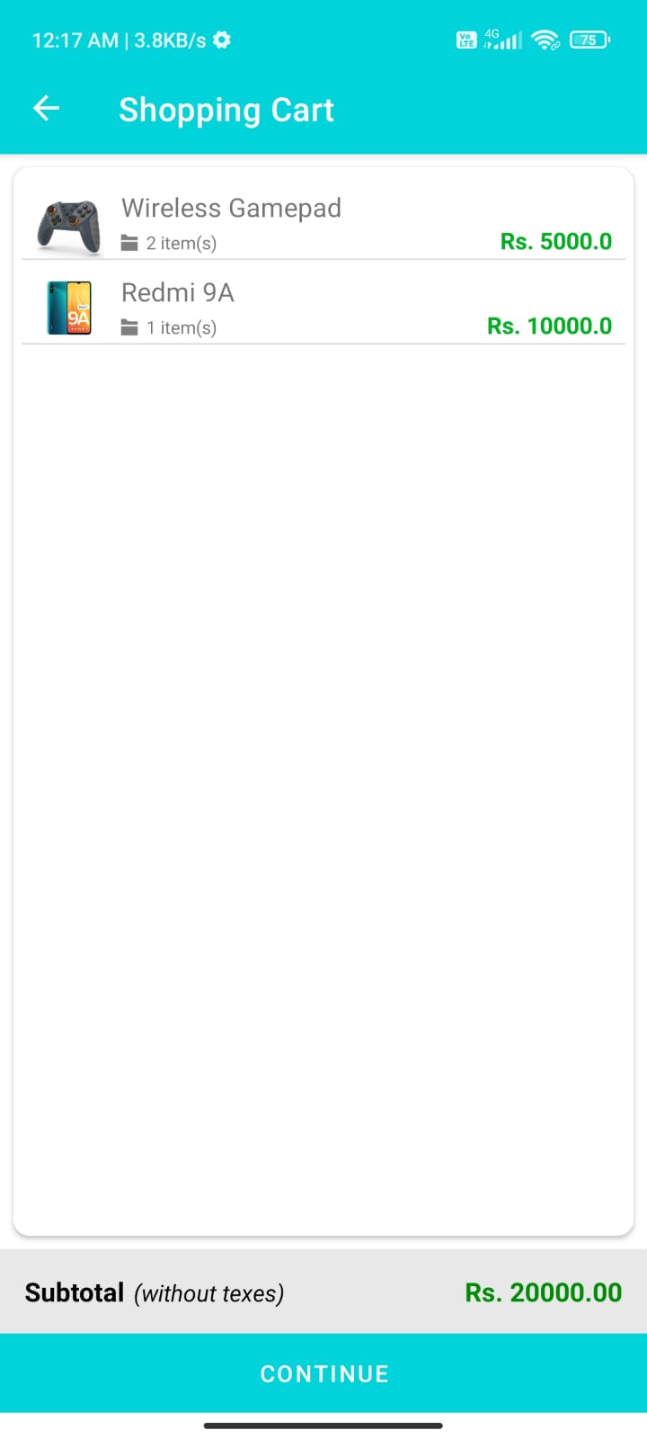
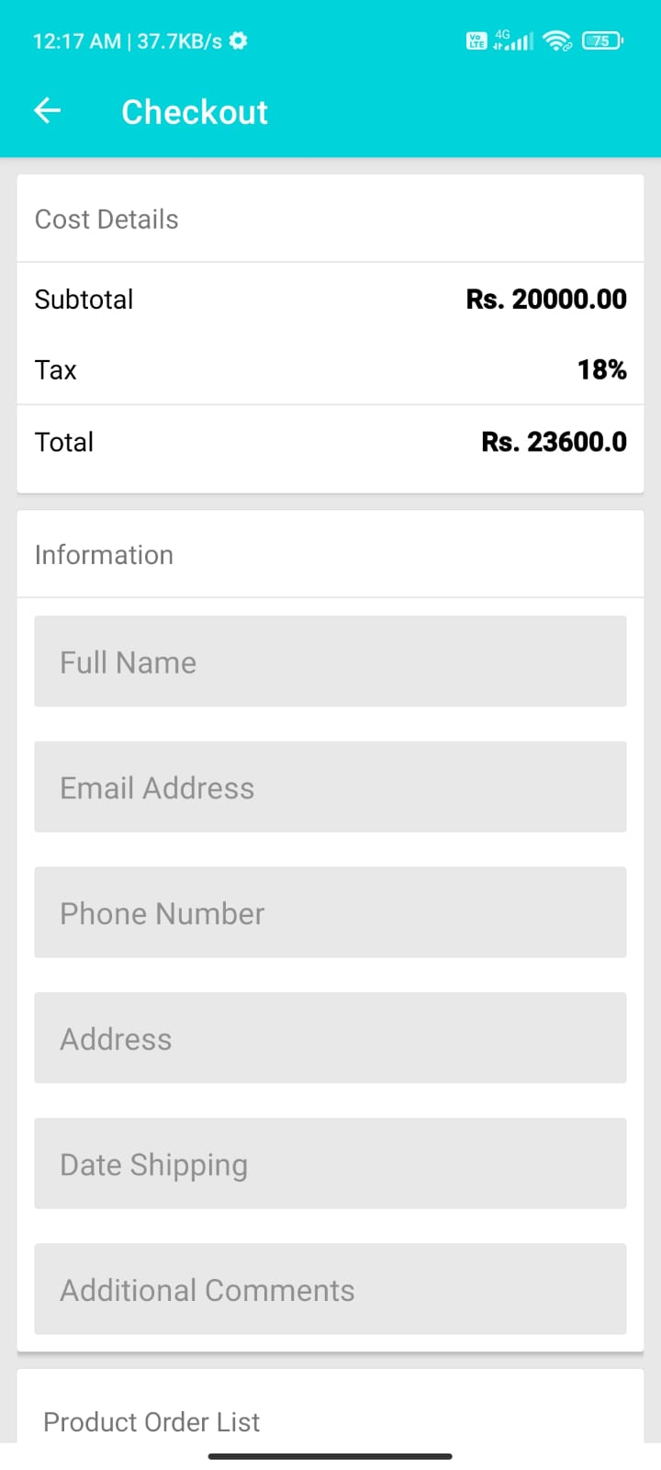
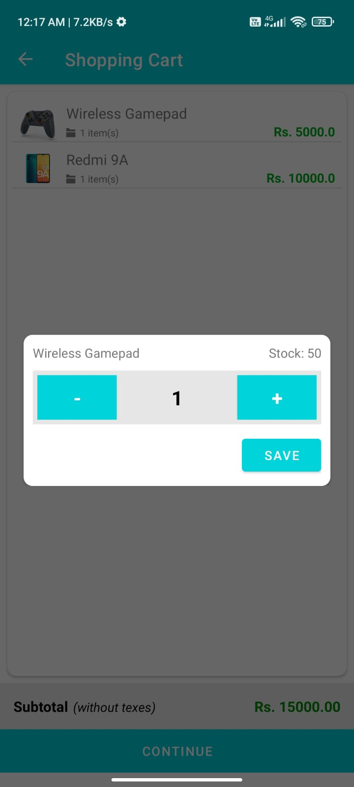
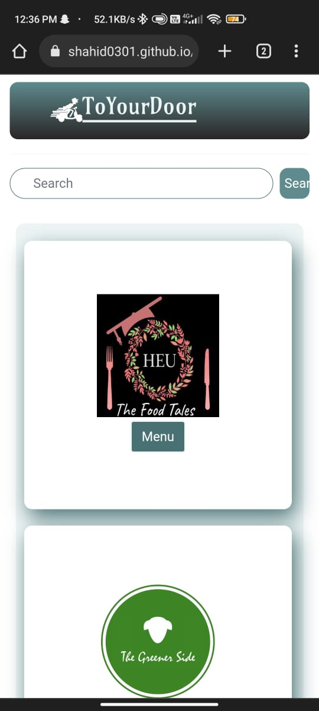
Working
AI RADIO
Page - 12
Notes:
Flutter is an open source framework by Google for building beautiful, natively compiled, multi-platform applications from a single codebase.

Slide 12
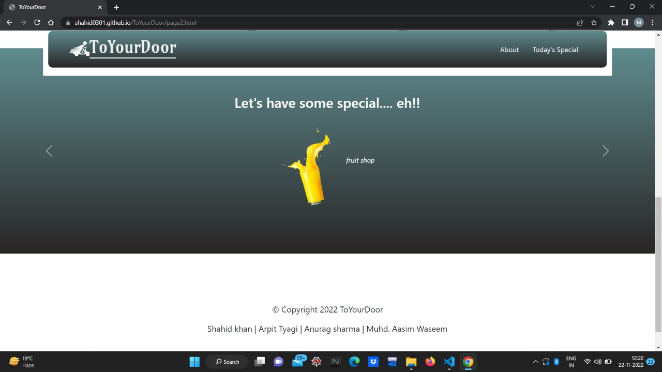
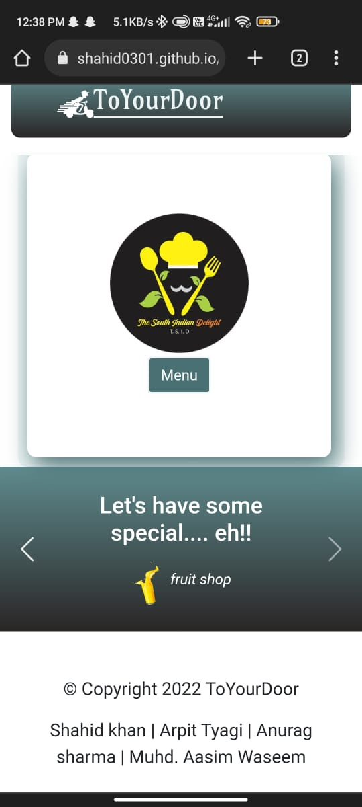
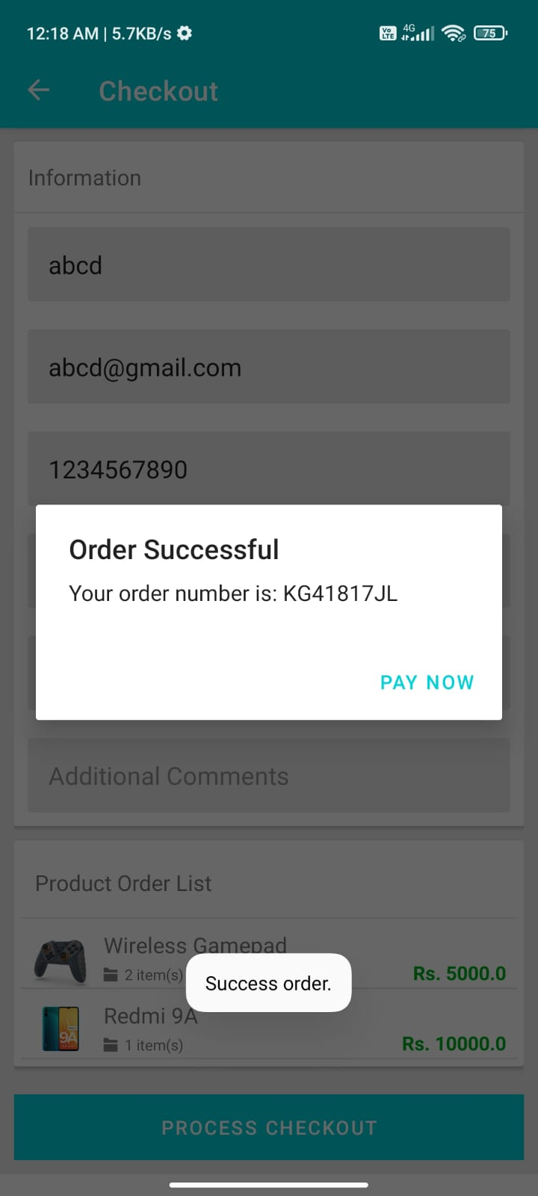
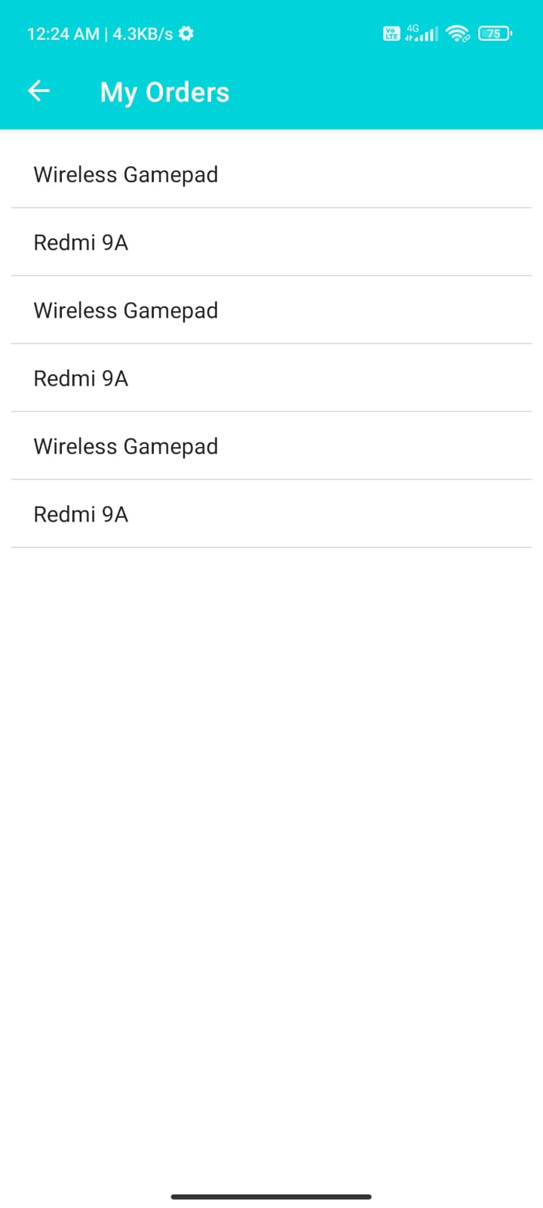
Working
AI RADIO
Page - 13
Notes:
Flutter is an open source framework by Google for building beautiful, natively compiled, multi-platform applications from a single codebase.

Slide 13
Conclusion
GLA complex (To Your Door) acts as a platform between user(student or faculties) and sellers of Shopping complex of GLA university to buy and sell products and services online.
Also it provides support to sellers to take there business online and grow it.
Future work concerns with developing a Admin panel and a data base to store products detail with a proper management system.
AI RADIO
Page -14
Notes:
Flutter is an open source framework by Google for building beautiful, natively compiled, multi-platform applications from a single codebase.

Slide 14
Thanks
AI RADIO
Page -15
Notes:
Flutter is an open source framework by Google for building beautiful, natively compiled, multi-platform applications from a single codebase.

